Slide 1
Text classification

Slide 2
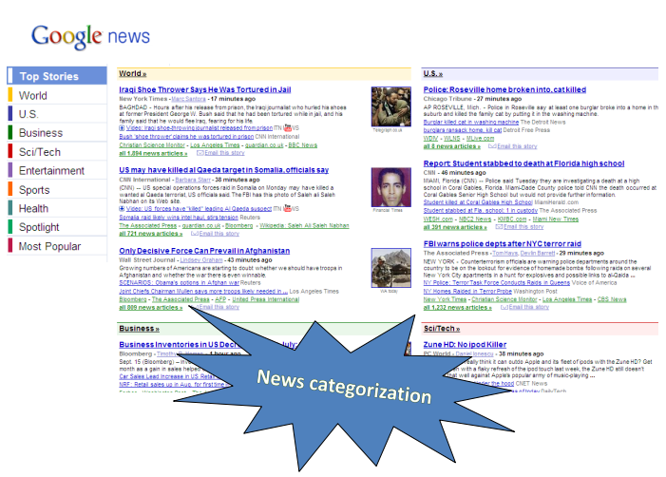
Text classification process

Slide 3
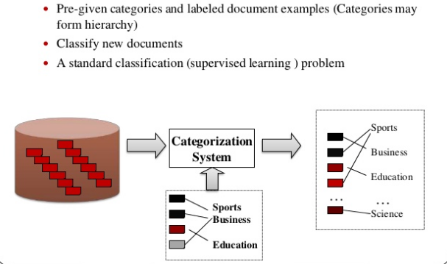
Text categorization

Slide 4
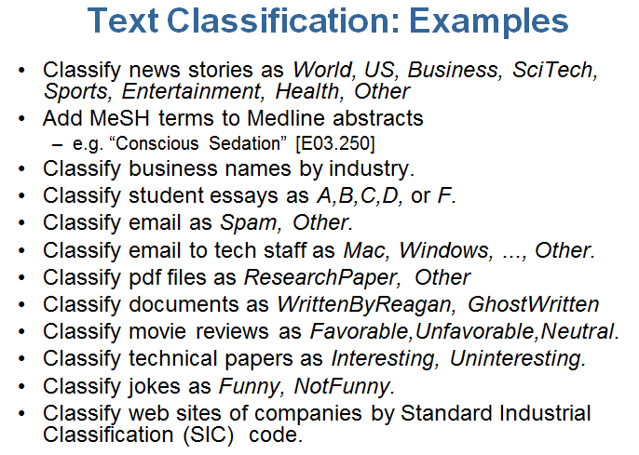
Text classification process

Slide 5
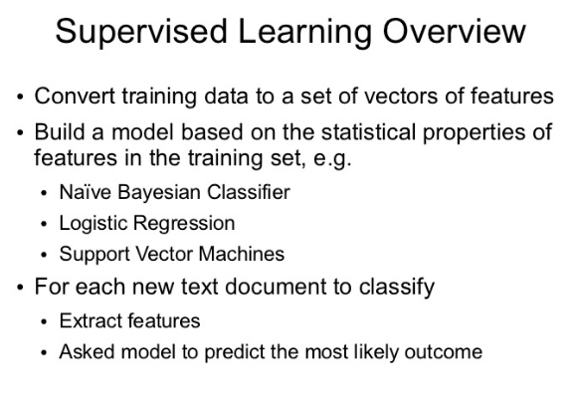
Text classification process

Slide 6
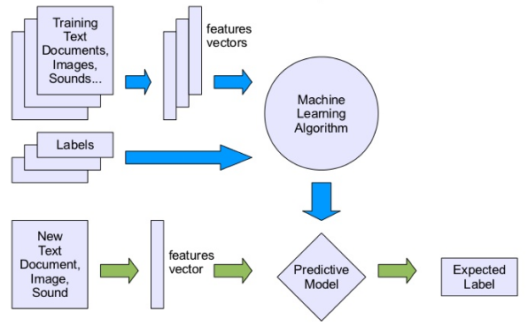
Text classification process: Supervised ML

Slide 7
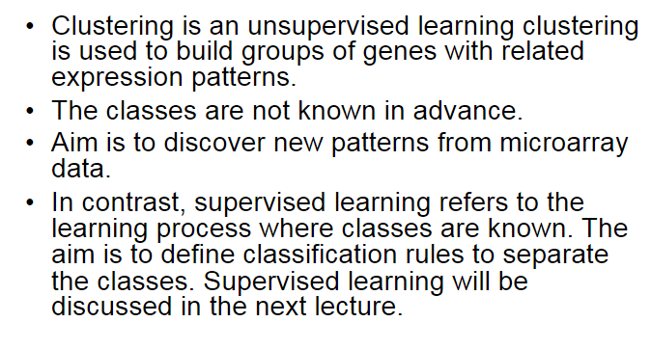
Unsupervised Machine Learning overview

Slide 8
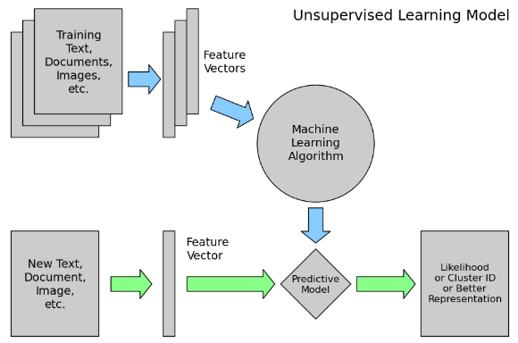
Text classification process: Unsupervised ML

Slide 9
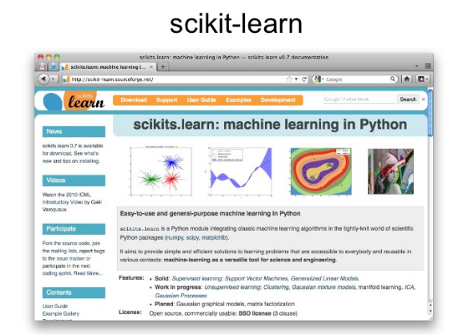
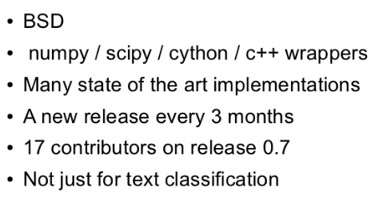
Libraries

Slide 10
Supervised ML algorithms

Slide 11
Data Preprocessing
From the last Lections you know:
punctuation, stopwords, digits removing
tokenizing, lemmatization or stemming each synopsis
transforming the corpus into vector space using:
TF-IDF
One-Hot encoding
Vectorization etc.

Slide 12
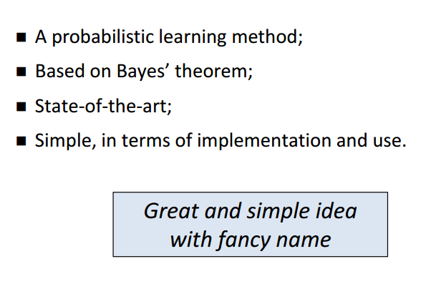
Naive Bayes classifier

Slide 13
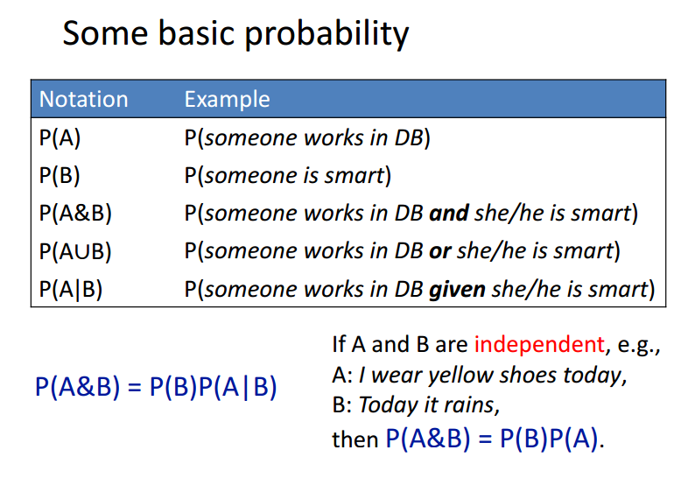

Slide 14
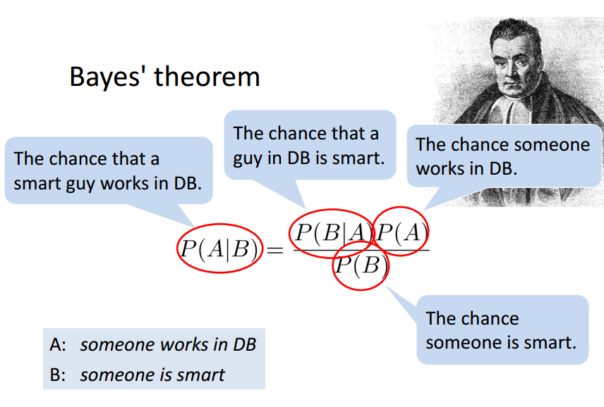

Slide 15
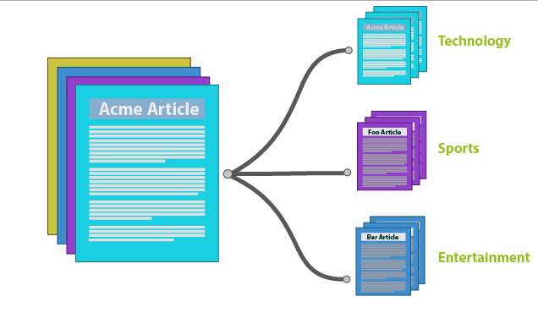
Results

Slide 16
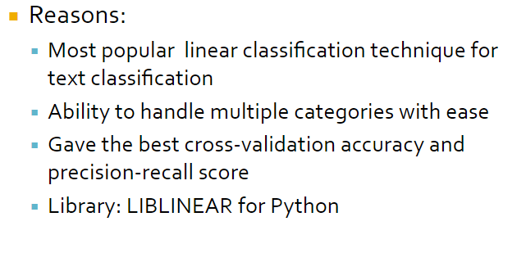
Logistic Regression

Slide 17
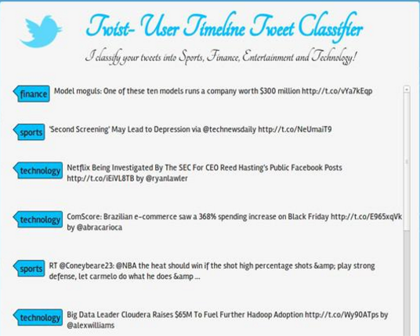
Example

Slide 18
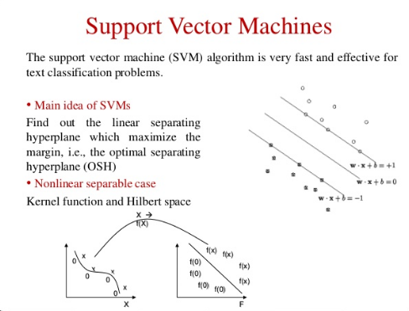
Example

Slide 19
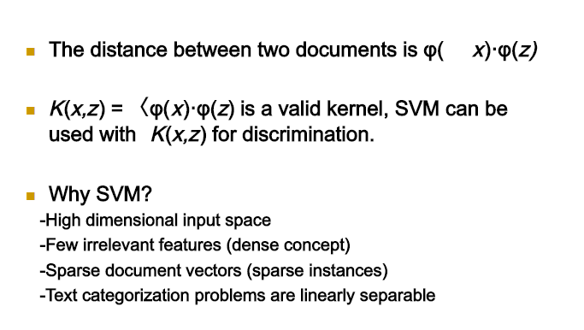
SVM

Slide 20
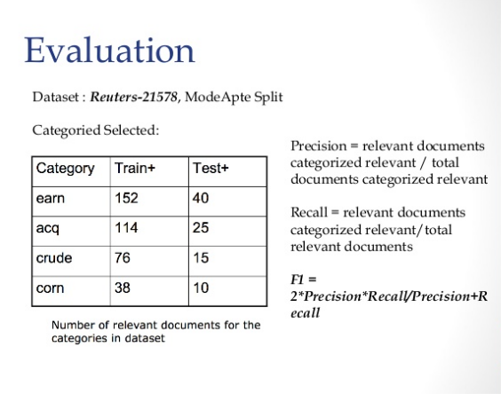

Slide 21
Unupervised ML algorithms

Slide 22
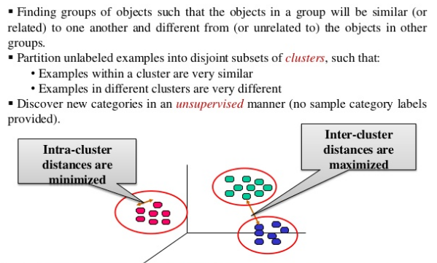
Why clustering?

Slide 23
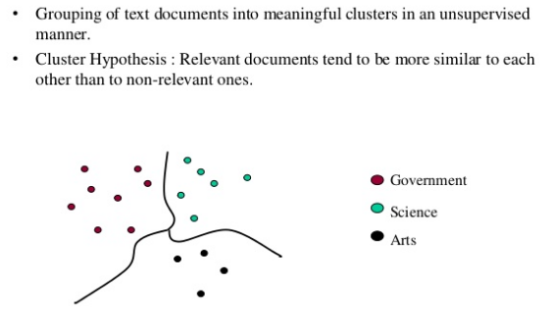
Document clustering

Slide 24
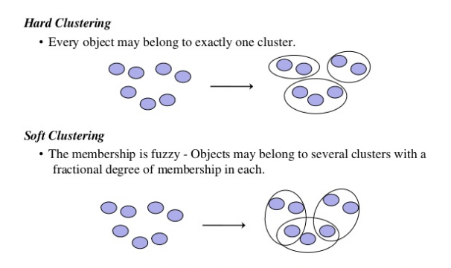
Document clustering

Slide 25
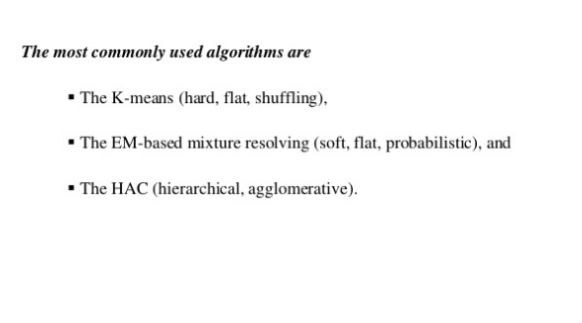
Document clustering

Slide 26
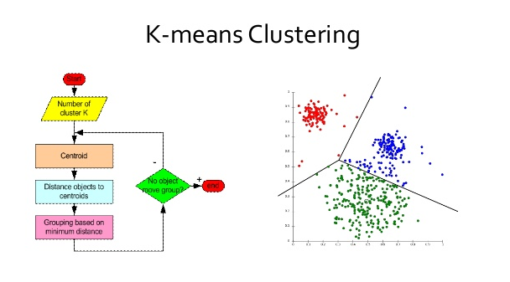
Document clustering

Slide 27
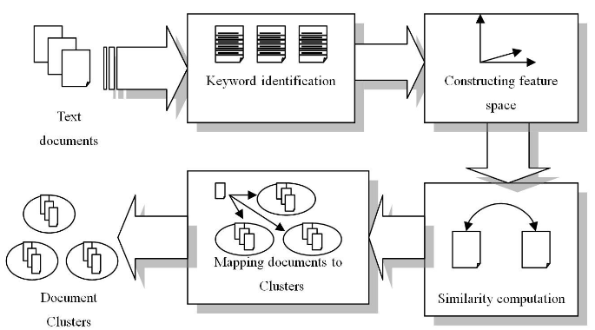

Slide 28
Thank you!

